Slide 1
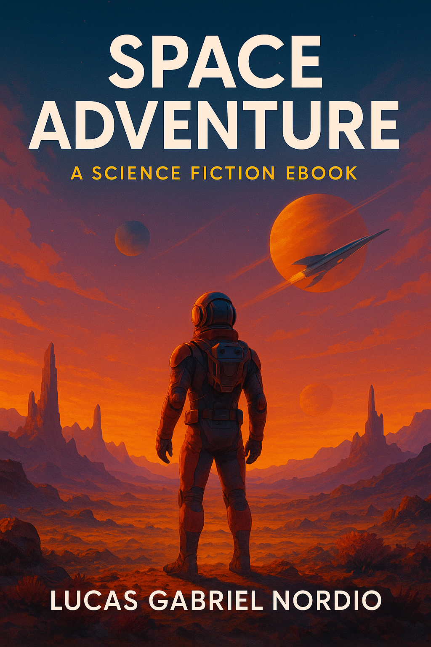

Slide 2
Epilogue: The Journey Begins
The Nomad II launched six months later, with Elara at its helm and a new crew of explorers behind her.
As they slipped into hyperspace, heading toward the next mysterious signal, she looked at the stars not as a void to conquer—but as a library to read.
And somewhere out there, the Archivists watched and waited, ready to reveal the next chapter of the universe.

Slide 3
Chapter One: The Signal
Commander Elara Voss tightened her grip on the controls as the scout ship Nomad sliced through the dense atmosphere of Kepler-186f. Lightning arced across the crimson sky.
Below, the alien terrain sprawled endlessly—jagged spires, fluorescent forests, and rivers glowing with bioluminescence. They had come chasing a signal—an ancient transmission, pulsing on a frequency long forgotten.
The crew of the Nomad were the first humans to reach this distant corner of the galaxy, tasked with exploration and, maybe, first contact. Elara was alone now.
The rest of her team had remained on Outpost Nova, the orbiting station above the planet. She volunteered for the descent—she needed to see it for herself. As the ship touched down in a clearing, she felt a hum—not through her ears, but her bones. The signal was close.

Slide 4
Chapter Two: The Monolith
The planet was alive in a way Earth never was. Trees swayed with no wind, and stones rearranged themselves when she wasn’t looking.
Her boots crunched over iridescent soil as she followed the coordinates deeper into the forest.
Then she saw it—a towering black structure rising from the earth like a buried skyscraper. The monolith.
It pulsed faintly, emitting the same rhythm as the signal they’d picked up. Elara approached it, and her suit’s sensors lit up. No radiation. No known composition. No entrance.
Until suddenly, there was one.
A doorway blinked into existence, perfectly rectangular, just tall enough for a human. Against protocol—but driven by something deeper—Elara stepped through.

Slide 5
Chapter Three: The Archive
Commander Elara Voss tightened her grip on the controls as the scout ship Nomad sliced through the dense atmosphere of Kepler-186f. Lightning arced across the crimson sky.
Below, the alien terrain sprawled endlessly—jagged spires, fluorescent forests, and rivers glowing with bioluminescence. They had come chasing a signal—an ancient transmission, pulsing on a frequency long forgotten.
The crew of the Nomad were the first humans to reach this distant corner of the galaxy, tasked with exploration and, maybe, first contact. Elara was alone now.
The rest of her team had remained on Outpost Nova, the orbiting station above the planet. She volunteered for the descent—she needed to see it for herself. As the ship touched down in a clearing, she felt a hum—not through her ears, but her bones. The signal was close.

Slide 6
Chapter Four: Return
Elara awoke back in her ship. Hours had passed—yet she remembered everything.
In her hand was a crystal disk, humming softly. A key, she assumed. Proof.
Back on Outpost Nova, she uploaded her findings. The data was undeniable. The signal, the structure, the Archive—it was all real. Her discovery would change the course of human history.
Exploration was no longer about finding habitable worlds.
It was about unlocking ancient knowledge, left behind by cosmic librarians.
As Earth buzzed with the news, Elara stood before the stars once again. There were more signals. More monoliths. More Archives.
And she would find them.
Thank You, Explorer.
Your curiosity fuels the future.
May your path be lit by the stars, and your journey never end.
Until the next signal…
— Lucas Gabriel Nordio

